Slide 1
UNIT - 4
MOSFET

Slide 2
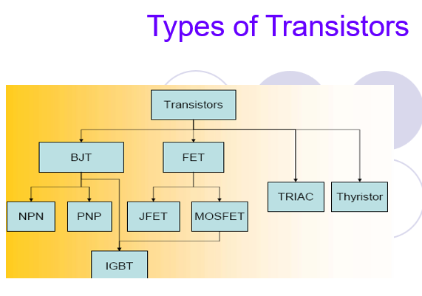

Slide 3
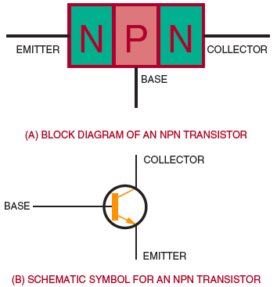
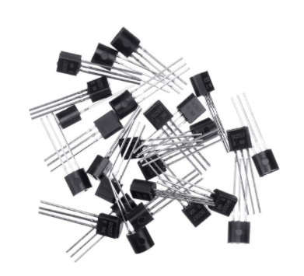
Transistor Construction
Figure NPN transistor.

Slide 4
In a NPN transistor, the current carriers are ………….
acceptor ions
donor ions
free electrons
holes

Slide 5
A transistor has …………………
QUIZ POLL
one pn junction
two pn junctions
three pn junctions
four pn junctions

Slide 6
Emitter is ................. Doped
QUIZ POLL
heavily
lightly
Medium
All of the above

Slide 7
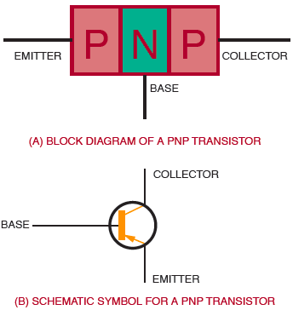
Figure PNP transistor.

Slide 8
Emitter is ................. Doped
QUIZ POLL
heavily
lightly
Medium
All of the above

Slide 9
In a pnp transistor, the current carriers are ………….
acceptor ions
donor ions
free electrons
holes

Slide 11
In a npn transistor, ……………. are the minority carriers
free electrons
holes
donor ions
acceptor ions

Slide 12
Collector has ............... size among all terminals in BJT
QUIZ POLL
least size
Medium
biggest
All of the above

Slide 13
The element that has the smallest size in a transistor is ………………..
QUIZ POLL
collector
base
emitter
collector-base-junction

Slide 14

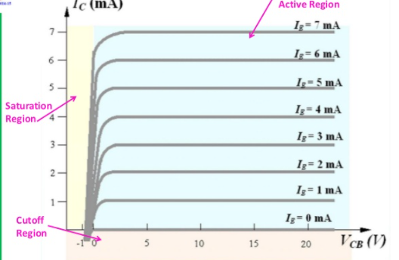
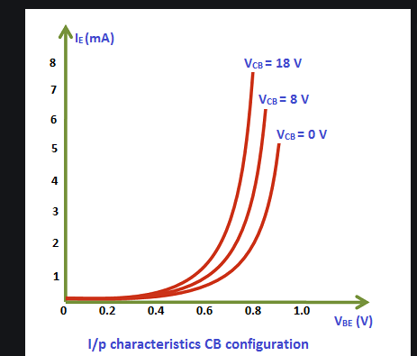

Slide 15
At the emitter base junctions of a transistor, one finds………….
QUIZ POLL
A reverse bias
A wide depletion layer
Low resistance
Both a and b

Slide 16
Most of the majority carriers from the emitter……………
QUIZ POLL
Recombine in the base
Recombine in the emitter
Pass through the base region to collector
Both a and b
Both b and c

Slide 17
MOSFET

Slide 18
MOSFET
It is a solid state device
It is a Voltage controlled Device
It is of two types
Depletion Mode D-MOSFET
Enhancement Mode E-MOSFET

Slide 19
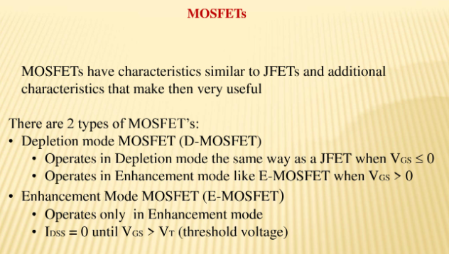

Slide 20
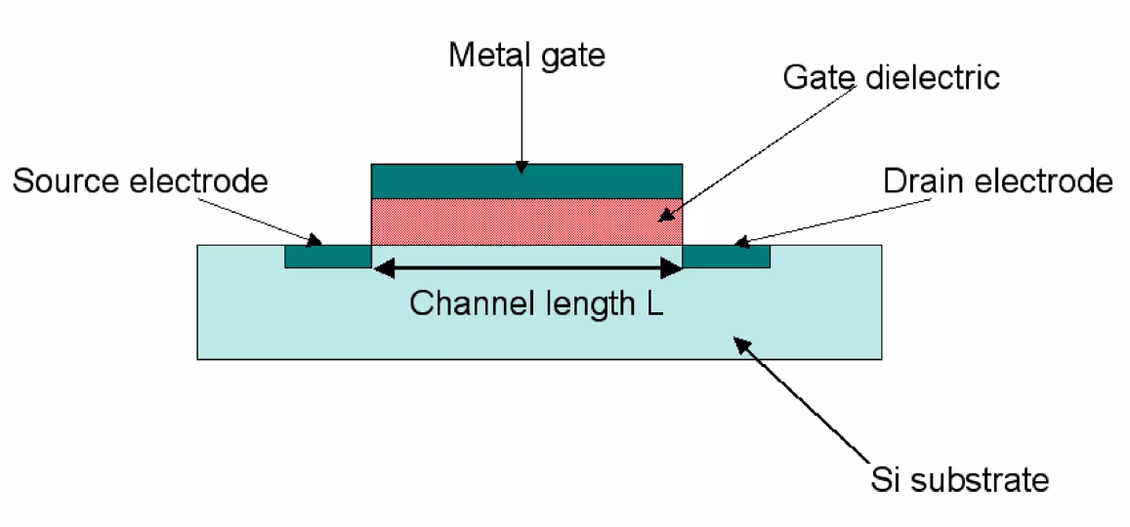

Slide 21
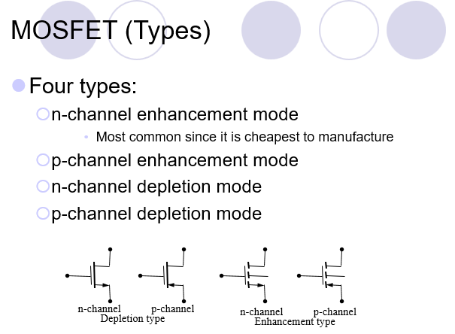

Slide 22
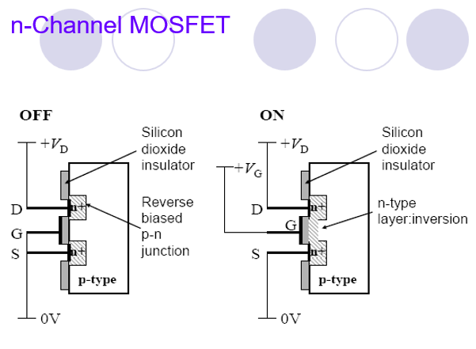

Slide 23
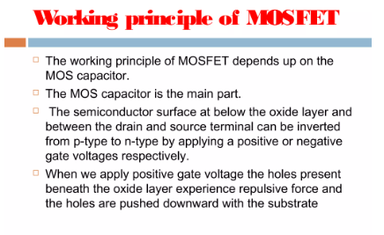

Slide 24
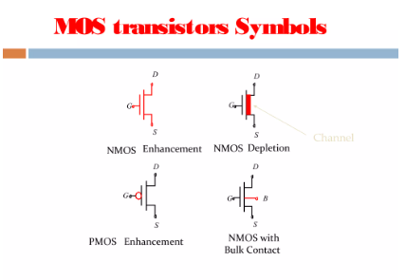

Slide 25
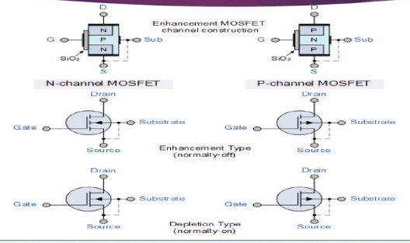

Slide 26
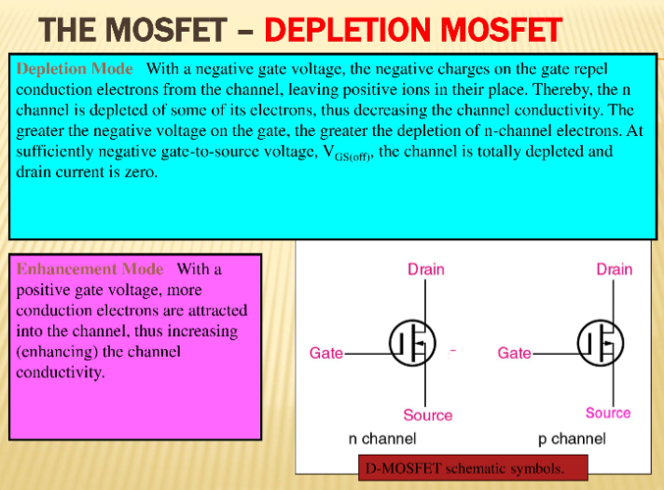

Slide 27
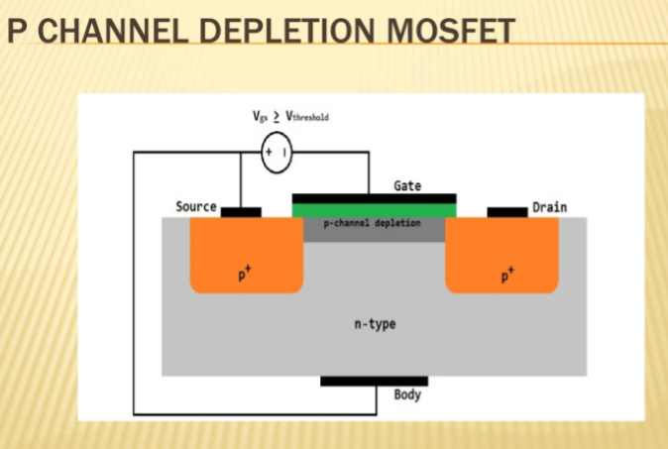

Slide 28
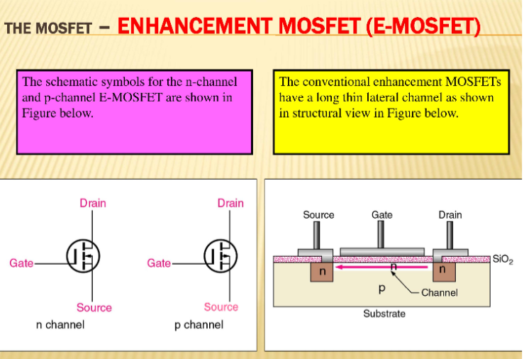

Slide 29
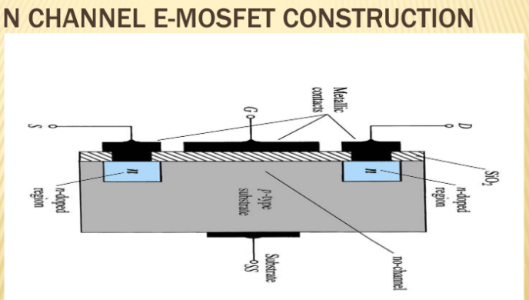

Slide 30
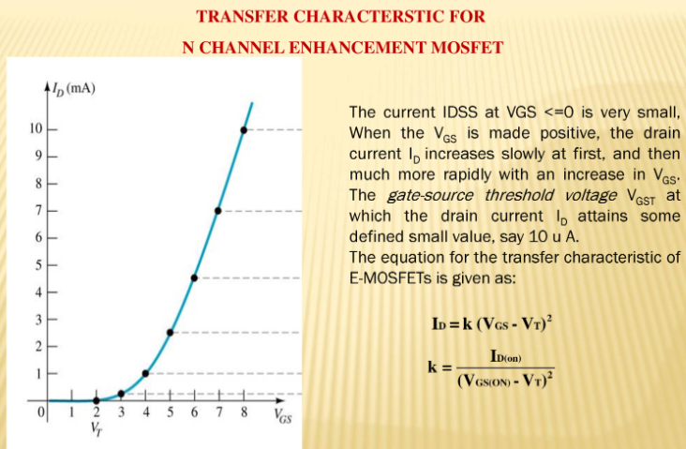

Slide 31
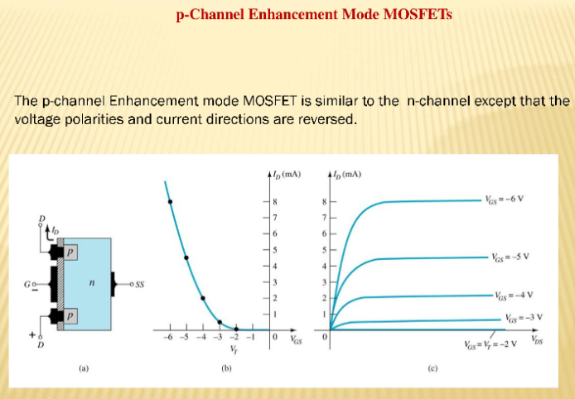

Slide 32
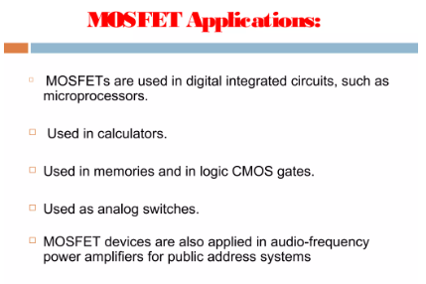

Slide 33
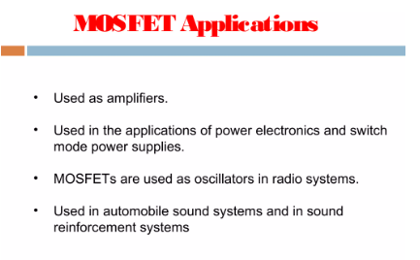

Slide 34
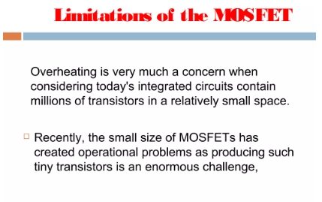

Slide 35
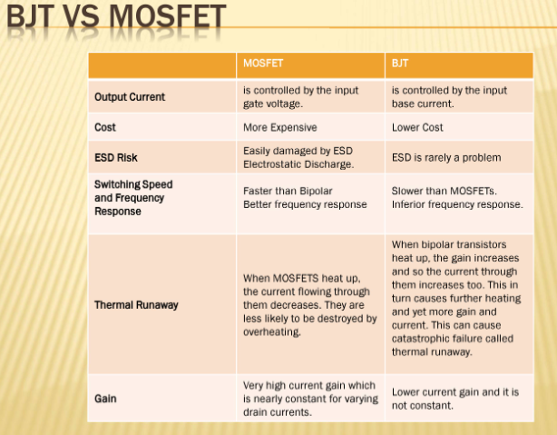

Slide 36
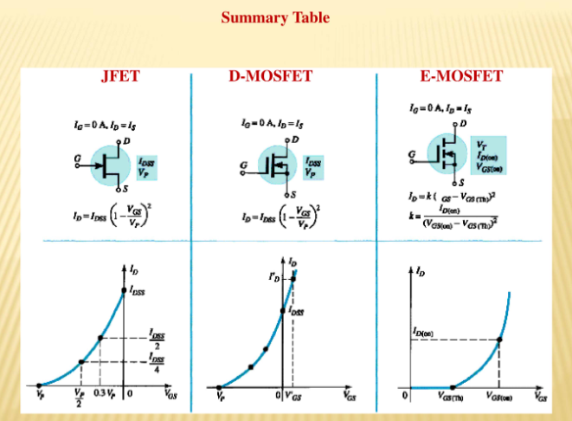

Slide 37
The MOSFET stands for
QUIZ POLL A.Metal oxidized selenium FET
B.Metal oxide surface FET
C.Metal oxide semiconductor FET
D.Metal of surface FET

Slide 38
Which of the following term does not belong to MOSFET:-
QUIZ POLL A) Source
B) Gate
C) Base
D) Drain

Slide 39
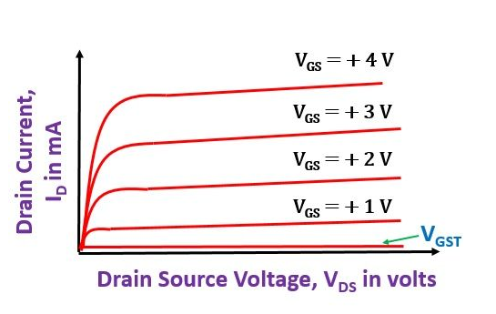
Characteristics of MOSFET

Slide 40
A MOSFET has …………… terminals
QUIZ POLL
two
five
four
three

Slide 41
Which transistor region is very thin and lightly doped?
QUIZ POLL
The emitter region
The collector region
The another region
The base region

Slide 42
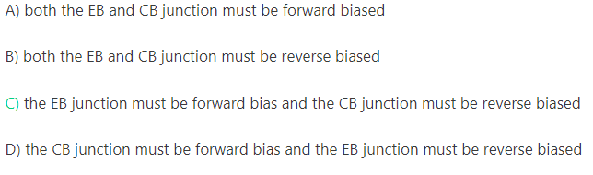
For a Transistor to function as an amplifier:-
QUIZ POLL
A)
B)
C)

Slide 43
With the E-MOSFET, when gate input voltage is zero, drain current is …..
QUIZ POLL
at saturation
zero
Less than 10 A
widening the channel

